Slide 1
Pedestrian Bridge Project
Started in 2013

Slide 2
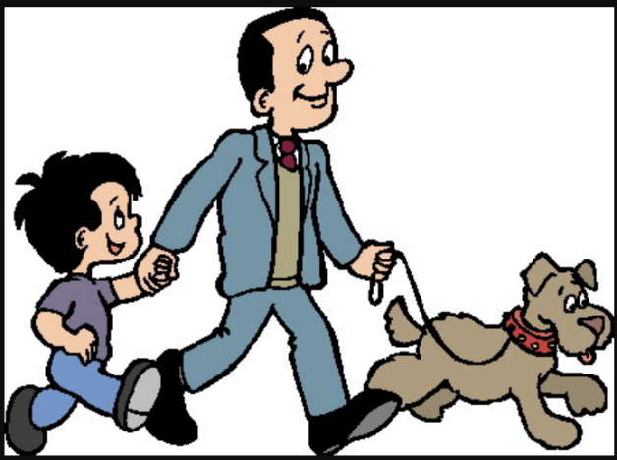
Goal Of The Project
The Pedestrian Bridge is to provide the option of safe walking between all village amenities
Goddard
Post Office
Health Center
Library
Town Hall Opera House
Church
Rec Field
Bookstore
Positive Pie
Municipal Building
Plainfield Co-op
Mill Street Park and Parking
Plainfield Park and Ride
The Project is Funded by the Vtrans Bicycle Pedestrian Program

Slide 3
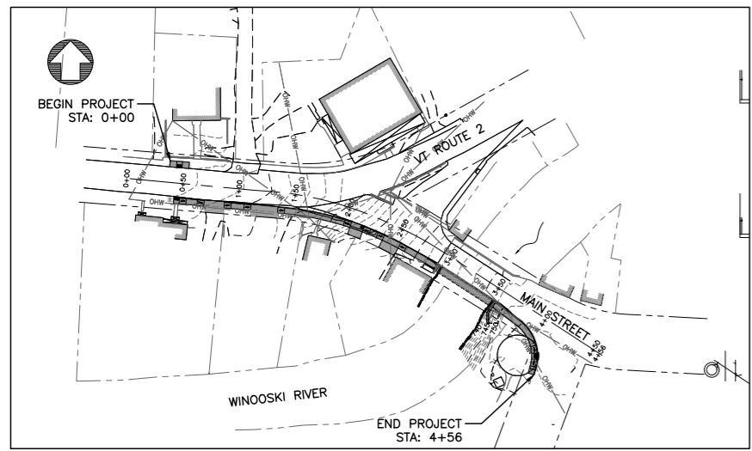
Focused on the Community
The purpose of the project is to provide an improved and expanded network of sidewalks in Plainfield Village, maximizing the capacity of residents and visitors of all ages and abilities to access local businesses and cultural and recreational amenities in the Upper Village (located on US 2) and the Lower Village (accessed at the intersection of Main Street and US 2), which is already served by improved bicycling and walking facilities.

Slide 4
History of the Pedestrian Bridge
2013 The Pedestrian Bridge began with a Conceptual Alignment Analysis by Broadreach Design that recommended for a Phase :
A free-standing, prefabricated pedestrian bridge adjacent to the existing Main Street Bridge, spanning the Winooski River
Segments of sidewalks on either side of the pedestrian bridge, connecting the Mill Street Park in the lower village to the municipal parking lot on US 2 in the upper village
A Vtrans approved crosswalk on US 2, opposite the Plainfield Town Hall Opera House
2014 The town was award funding for design/construction for Phase A
$393,000 ($357,000 VTrans; $36,000 Town) 90/10%
2017 The town was awarded Make-up funding for the existing project
$148,627 ($118,902 Vtrans/ Federal Grant; $29,725 Town) 80/20%
Note: additional funds were needed for cost of engineering & project manager; design work exceeded estimated budgeted amount
2018 Engineering and Historic concerns: The design was changed from free standing pedestrian bridge to one attached
to the current bridge
2019 The town was awarded additional funding:
$47,500 ($38,000 Vtrans/ Federal Grant; $9,500 Town)80/20%
Note: additional funds were needed because the change of design (from separate pedestrian bridge to hanging sidewalk incorporated into existing bridge) impacted the methods used for construction and required additional permitting
2020 The town was awarded addition funding again:
$332,573 ($266,058 Vtrans/ Federal Grant; $66,515 Town) 80/20%
Note: addition fund were needed because construction bids came in higher than anticipated
2020 The select board worked successfully with VTrans to combine the design for US 2 intersection improvements. The modified pedestrian bridge design excludes the sidewalks on the west side of the bridge and the US2 crosswalk between the municipal parking lot and the Town Hall Opera House.

Slide 5
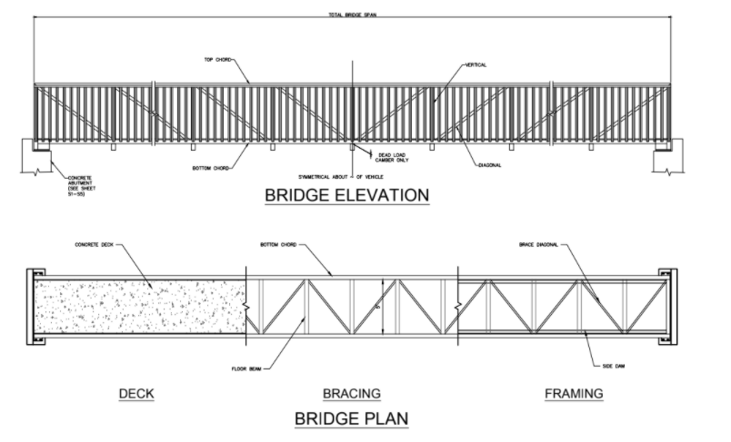
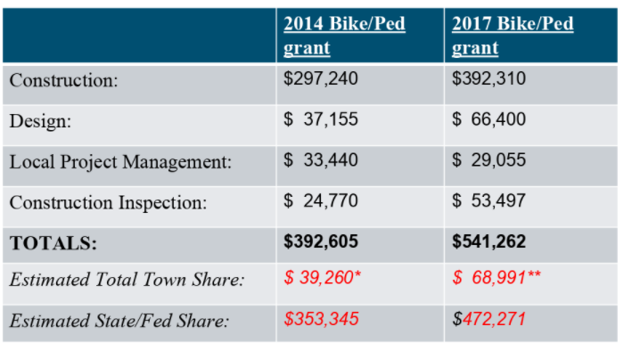
First Bridge Design
Free-standing pedestrian located adjacent to south side of Main Street vehicular bridge

Slide 6
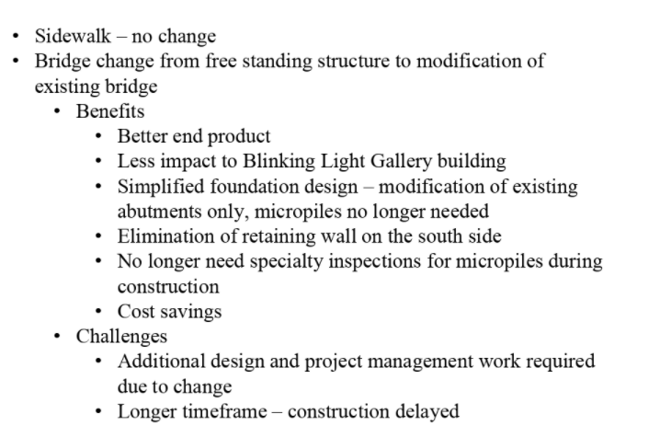
Second Design

Slide 7
Project went to bid 2020
The only two bids we received
for the project
JP Sicard $927,002.75
Neil Daniels $732,155.00

Slide 8
Where we are now
New Plan with a New estimate of cost

Slide 9
Project went to bid 2021
Vtrans worked with us to come up with a phased process to help the town reduce the cost of the project. They will finish the sidewalk on the west side of the bridge at the time of the US 2 improvements
Bids received on for the reduced scope of work
Neil Daniels $649,790
S.D Ireland $1,178,775.00
These Bids are good until February 22, 2021

Slide 10
Moving forward with 2021 Construction
Estimated cost for Project
Amount need to move forward
Construction estimate $649,790
10% overrun $ 64,979
Project Site Engineer $ 65,000
Outstanding Invoices $ 2,890
Town has paid as of June 2020 $136,121
$918,780
**Note Construction cost are estimated, we may want to plan to use full grant for budgeting purposes
Grant Project funds total $921,700
Federal dollars $741,604
State dollars $ 35,056
Town dollars $145,040
Town portion of grant $145,040
Outstanding invoices $ 2,890
$147,930
Already paid by the town $ 21,083
Estimate amount needed $126,847

Slide 11
Cost to Not Move forward with Project
Grant Federal Pay Back prevision
If the town doesn’t proceed with the project, we will need to pay back any federal money give toward the project
Reimbursed Federal Money from Grants $127,820.15
Amount that the State was reimbursed $ 35,056.67
Total we will need to budget
to pay back the Federal Grant $162,876.82
Amount we have paid as of June 2020 $ 21,083.00
Outstanding invoice $ 2,890.00
Est. for additional cost not billed yet $ 2,000.00
Estimated cost to the town $188,849.82

Slide 12
Items to consider as we move forward
Contractors only hold their price for 30 day and delays on accepting the bid would put us at risk of losing the contractor or our current bid price.
If this project goes back out to bid, we will be at risk of getting higher bids.
As part of the US Route 2 project, VTrans has agree to help with the second phase of this project and put in the sidewalks from the west side of the bridge up to the parking lot in front of the Town Hall Opera House at no cost to the town. If we don’t continue with this project, they would have no reason of put that sidewalk in and would remove that from US Route 2 project.
We have not received an updated price from the VHB (project site engineer) for the reduced scoped project.

