Slide 1
Pedestrian Bridge Project with the option of doing Main Street Bridge maintenance
Town of Plainfield
9-12-2022

Slide 2
History
Construction of Ped Bridge started construction in August of 2021 (Late start due to traffic plan approval)
Project had some unexpected issues at the start of the project in front of the apartment at the corner of bridge. There were multiple layers of concrete slabs, the T-beam that went back toward Route 2 that was cracked and material had washed out causing sinkholes. We need to re-design plans that would address the issues. Delay was caused because the structure engineer was on vacation and needed to quarantine due to Covid before coming to look at the issues, there was additional work that was needed to create an extra wall and a slab and the need for the contractor to build a stairway in the back of the apartment, to allow the town to shut off the front entrance of the apartment during construction. The building of the new entrance cause overage on the project.

Slide 3
Contractor continued to work through the project and found additional changes to the project that was able to save money on the leaving the town with current overages of $1211.68. There are additional estimated engineering overage of $20,669.00, due to the additional time needed for the project.

Slide 4
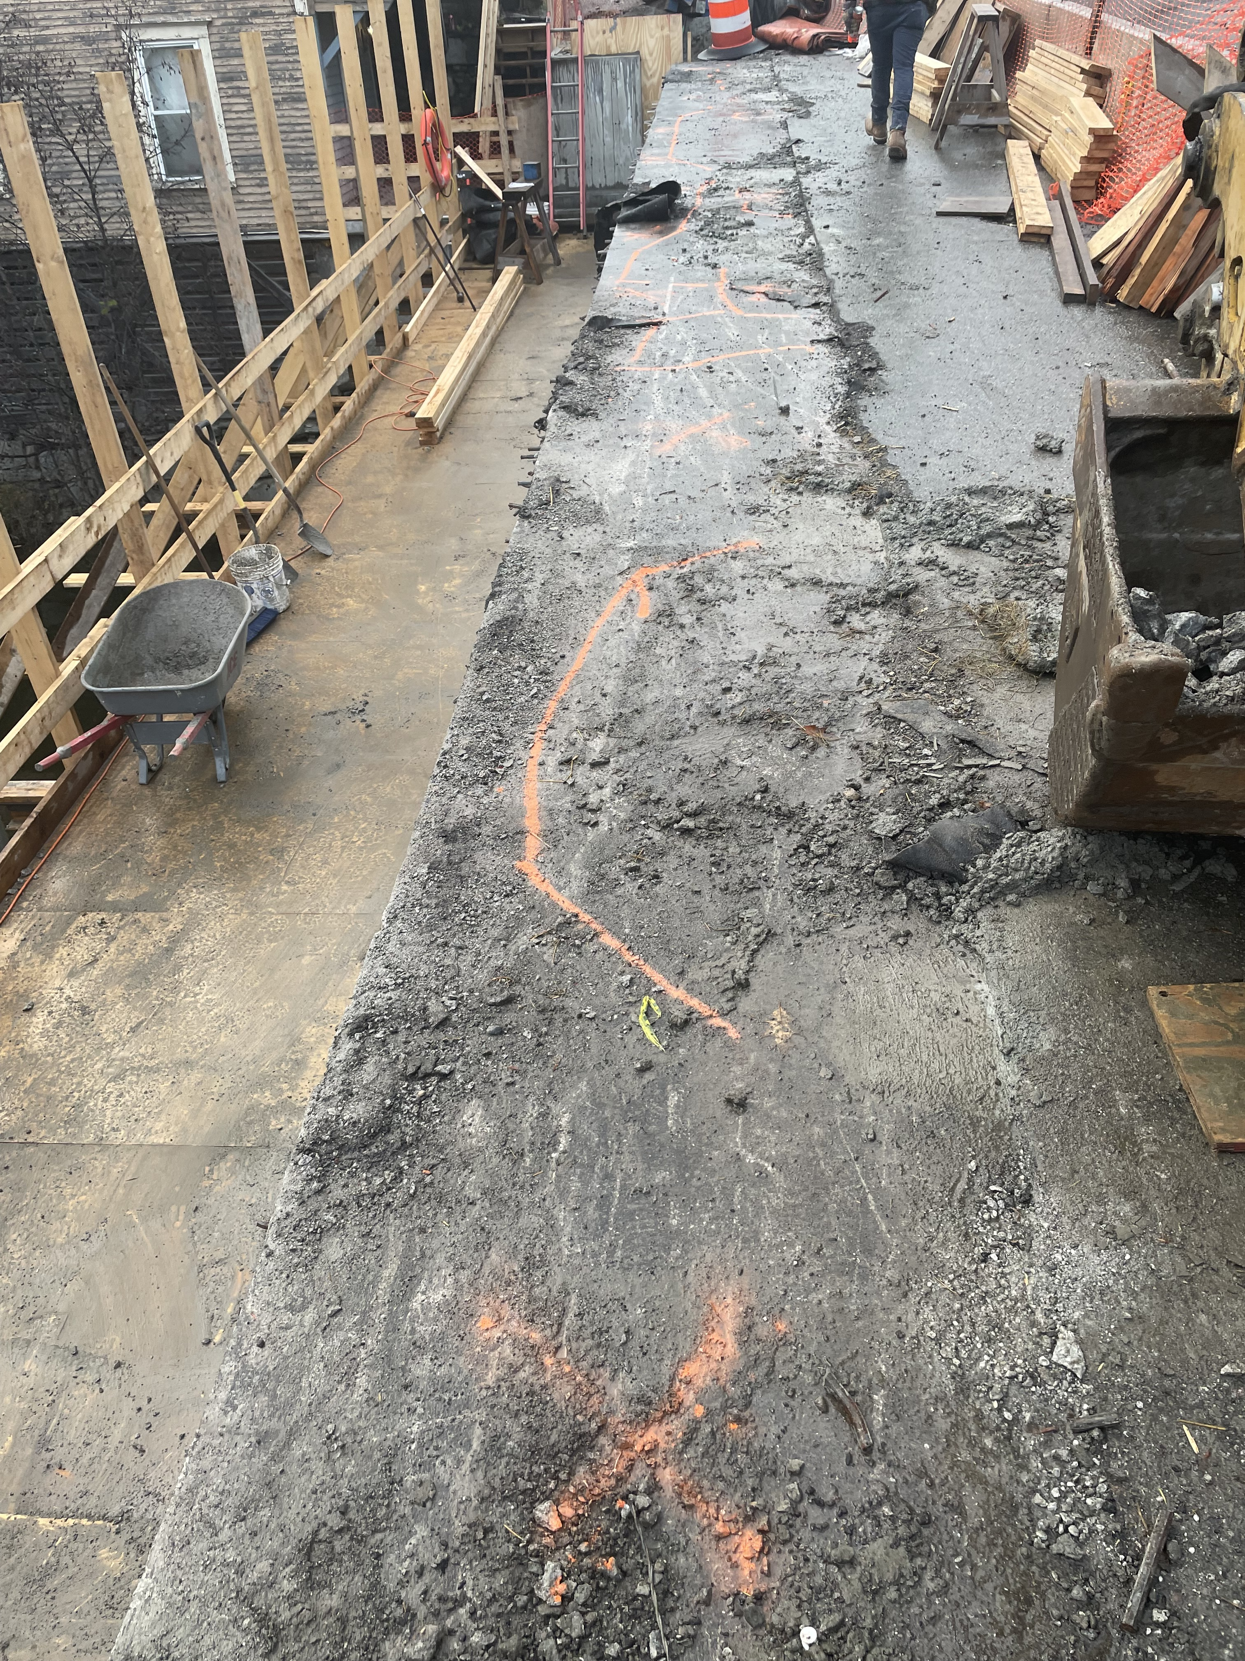
Inspection of the Main Street Bridge
Fall of 2021, it was brought to the town's attention, by the contractor, that the 16-year-old membrane was starting to fail and was causing additional damage to the bridge. With the ability to look underneath the bridge and underneath the sidewalk section of the Bridge decking it allowed Mike Nolan and Vtrans Bridge Inspectors to inspect the bridge closer.

Slide 5
Looking for ways to get the Main Street Bridge Maintenance done
The Spring of 2022, Vtrans and the Daniels Construction started to help the town coming up with options and estimated cost to maintain the bridge.
The Select Board went to the town people to get permission to borrow money to fix the bridge.
Vtrans found additional $375,000.00 for this project. Vtrans share is 80% and the Towns share is 20%. If the project exceeds $375,000.00, it will be on the town.

Slide 6
Options and Cost the Town were given

Slide 7
Town looked at Options
May 3rd
May 9th
Select Board meet with Contractor and Engineer, and they expressed again the recommendation to close the bridge to get a better product and save about $140,000.00.
Select board then went back to look at options and to see if we could get the cost of additional emergency services included in project so the bridge could be closed.
July 23rd
At special meeting it was determine to move forward with one lane open, for three months, to better service out community.

Slide 8
VHB and Daniels Construction Start processing change order and new plans.
July 29th
Select Board signed change order for Ped Bridge Project to include the deck maintenance on the Main Street Bridge.
August 1
Change Order approved and signed by Vtrans
Traffic Planning Begins
Daniels Construction started to working on traffic plans and plans to put traffic on the old sidewalk, which included complete investigation of the bridge and a review of the historic plans, to determining the weight load that the bridge could handle
August 11th
Town decided on desired traffic detour plan. Traffic will not be able to turn right into Plainfield Village from Route 2 coming from Marshfield direction.

Slide 9
Where we are today

Slide 10
It has been determined that sidewalk can’t hold the Traffic Load

Slide 11
Other Obstacles
Width of the Bridge
Keeping Contractor’s Employees Safe
Age of the Bridge
Current Damage to the Underneath of the Bridge
The Project Team tried to come up with options to meet the Towns goal of keeping one lane open

Slide 12
Current Options
Closing the bridge for a 28-Day Period – If the town elected to close the bridge Daniels Construction would be given a 28-Day period to repair the bridge deck. While this would require a detour for all traffic, the detour would only be in place for 4 weeks rather than three months if one lane were open. As previously discussed, closing the bridge would also result in an overall better product and cost savings to the town. Therefore, the project team is recommending this action as this would allow for the repairs to the bridge deck to occur and the duration of the closure would only be 4 weeks.
Postpone Structural Repairs – Plainfield could elect that the option above is not acceptable. In this case Daniels Construction would be directed to complete the remaining work for the original scope of the project. No structural repairs would be made to the concrete bridge deck. However, they would pave the bridge and approaches would provide some (minimal) protection against future deterioration for the next 5-10 years.

Slide 13
Things the town needs to Consider
Doing the Maintenance now
The funds are available
The contractor is on sight
The engineer is on sight
The Town currently has a Historical Permit in place
The short notice to the businesses in town
Potential longer Emergency services response times
Save money by combining projects

Slide 14
Not doing the Maintenance
Would cost more to do the repairs later
Will run into the same issues of needing to close the bridge
Town may be able to time it with the Route 2 project
Could look at other options of getting across the river to reduce the concern of the of the detour
Would need to find new funding
What time may do to the bridge
May help the current business in town

